Slide 1


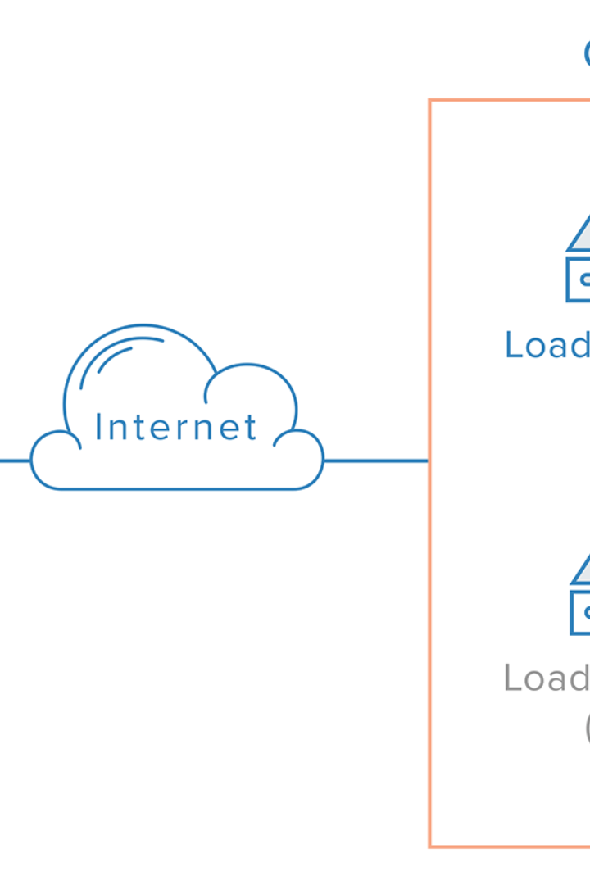
DEMO#4
Mariam Osama Saleh
Security Team

Slide 2
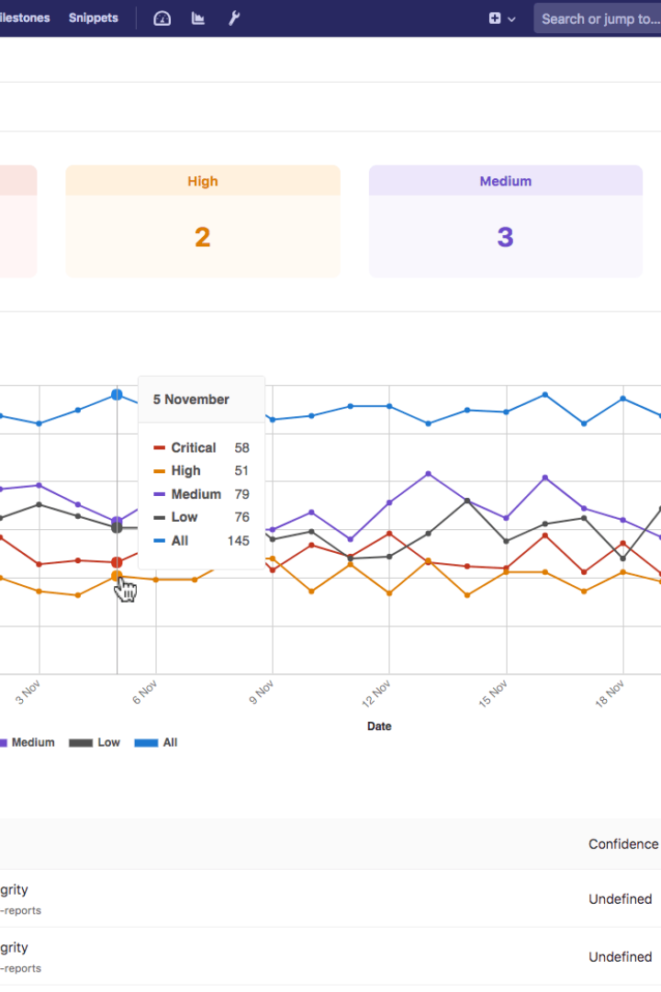
Business Value
Our security tool is an essential part of any business, even if the intended customer doesn't have the necessary expertise to integrate our tool. The security tool helps detect any existing vulnerabilities and proposes solutions, ensuring that your business stays secure and your customers satisfied.

Slide 3

Recap of Sprint 2
Before we dive into Sprint 3, let's quickly recap our achievements in Sprint 2, where we designed a utility- the Kubernetes Cluster Scanner Tool. This utility performs security scans on Kubernetes deployments, identifying vulnerabilities and security risks in your Kubernetes environment.

Slide 4
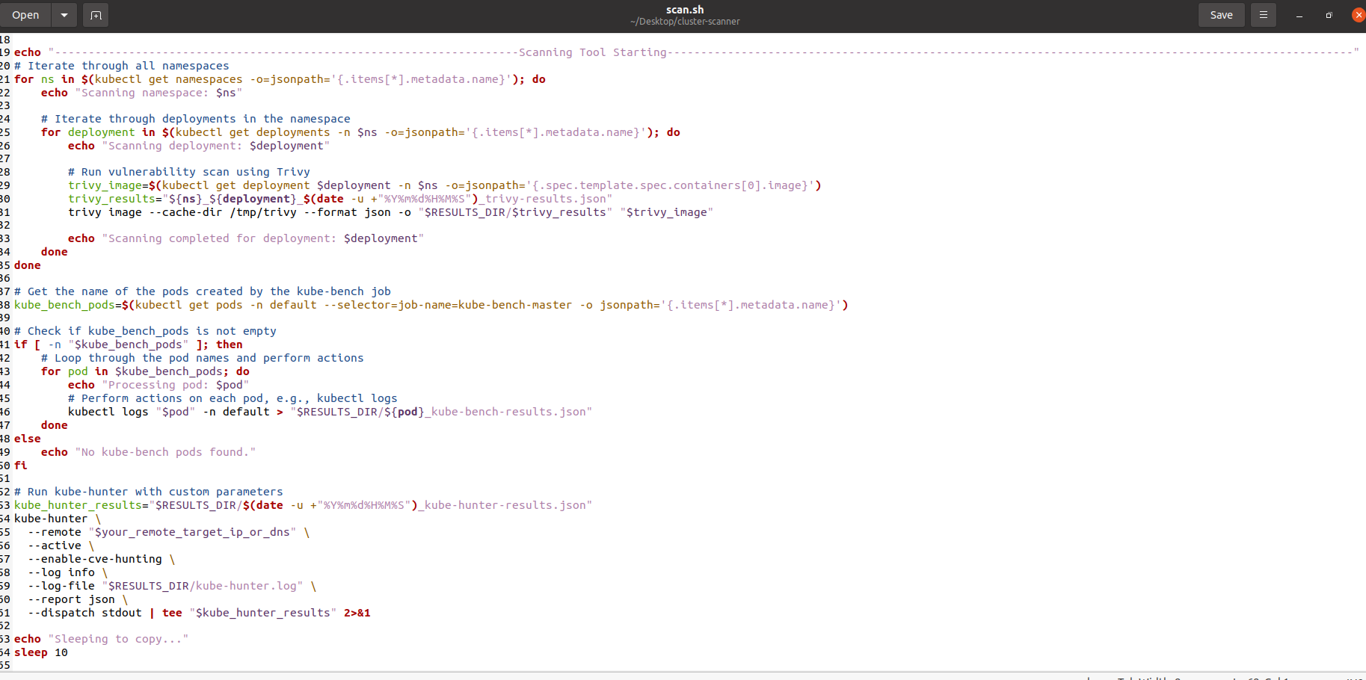

Scanning Tool
The scanning tool automates the scanning process across different namespaces, identifying any potential vulnerabilities or security risks across your Kubernetes deployment. Read on to learn about the security tools we use.

Slide 5
Tools Used
At Kubernetes, we believe in using the best-in-class open-source security tools to ensure the safety of your systems. Below are some of the tools we use and their benefits:
Trivy
Kube-Hunter
Kube-Bench
Trivy maintains a vast database of vulnerabilities to identify security issues and scans container images for vulnerabilities for efficient Kubernetes deployment.
Kube-Hunter proactively probes Kubernetes clusters to identify potential security weaknesses and provides insights into various attack vectors and cluster configurations.
Kube-Bench assesses Kubernetes clusters against CIS (Center for Internet Security) benchmarks to ensure compliance with industry best practices. It also offers guidance and automation for faster benchmarking.

Slide 6
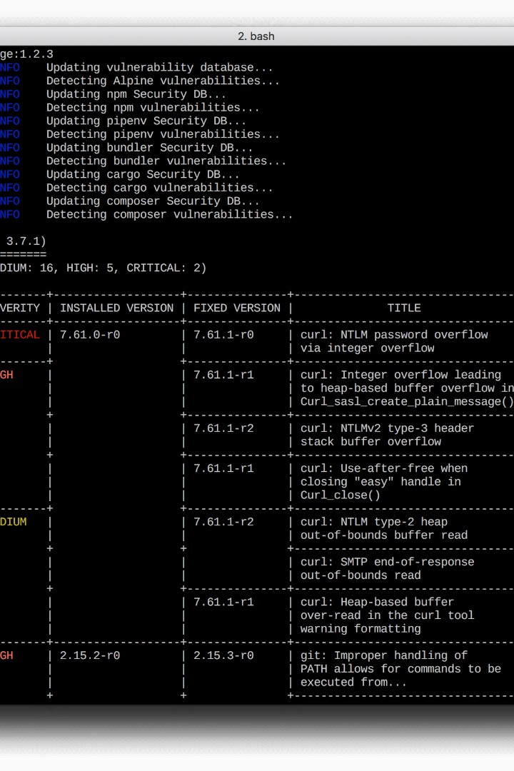
Trivy
Trivy allows you to maintain a comprehensive vulnerability database, making it effective in identifying vulnerabilities and scanning container images for vulnerabilities necessary for efficient Kubernetes deployment. Trivy is updated regularly and is accessible as an open-source tool.

Slide 7

Kube-Hunter
With the ability to simulate real-world attacks, Kube-Hunter proactively probes Kubernetes clusters to identify potential security weaknesses. It is community-driven, benefiting from a wide range of contributors, and provides insights into various attack vectors and cluster configurations.

Slide 8
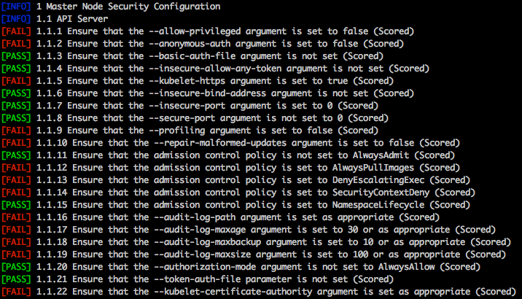
Kube-Bench
Kube-Bench assesses Kubernetes clusters against CIS (Center for Internet Security) benchmarks. It ensures compliance with industry best practices, offers guidance on hardening cluster security postures, and automates the benchmarking process. Kube-Bench is widely adopted by the Kubernetes community and recognized as a standard for cluster security.

Slide 9
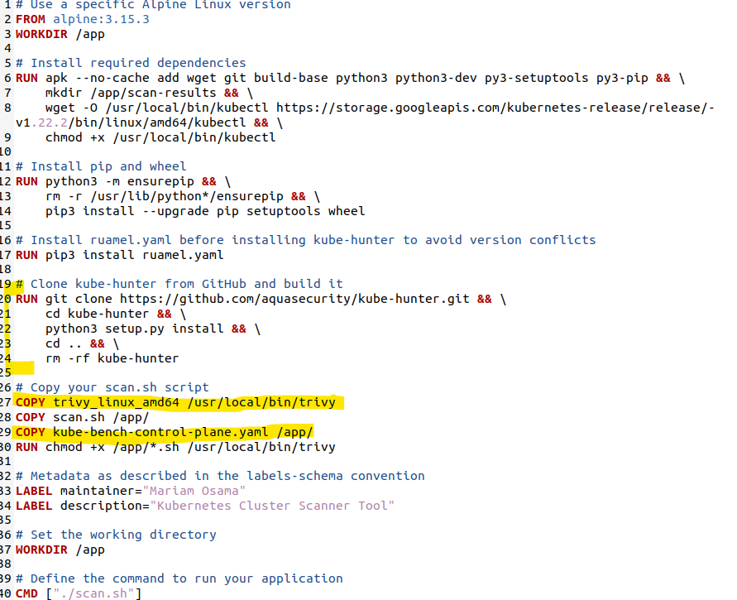

Slide 10
Recap of Sprint 3
Before we dive into Sprint 4, let's quickly recap our achievements in Sprint 3. We created a persistent volume and deployed our tool into our Kubernetes cluster to detect potential vulnerabilities and security risks.

Slide 11
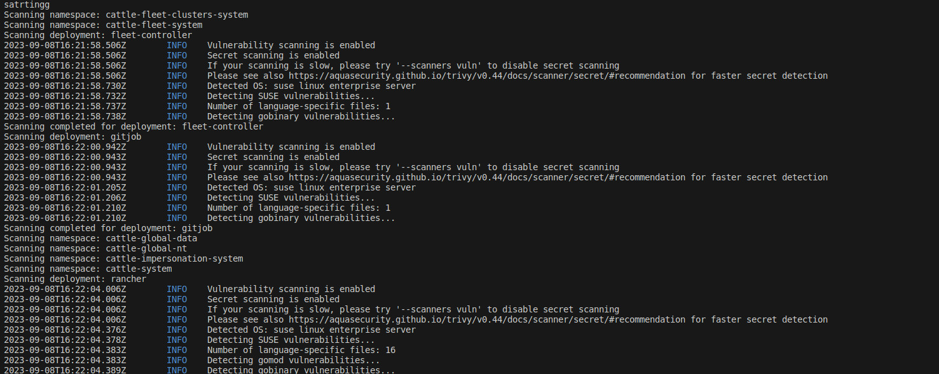
Tool Deployed in Cluster
We deployed our tool in the Kubernetes cluster to detect potential vulnerabilities and security risks and ensure the overall safety of the cluster's operations.

Slide 12
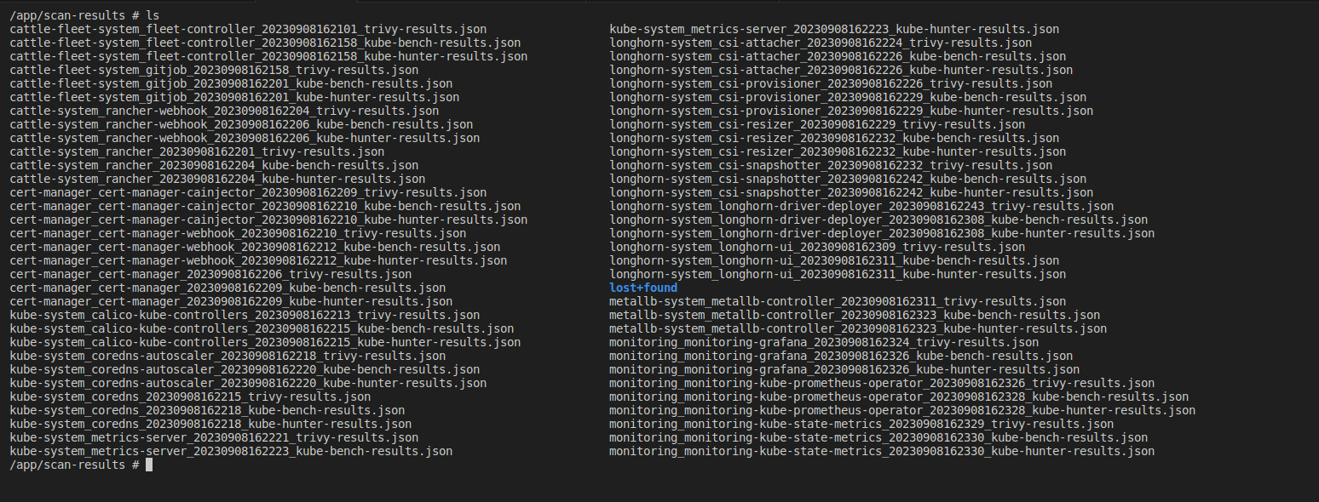
Analysis Results
We analyzed the prioritized results and detected potential vulnerabilities and security threats after running our tools on the updated Kubernetes cluster.

Slide 13
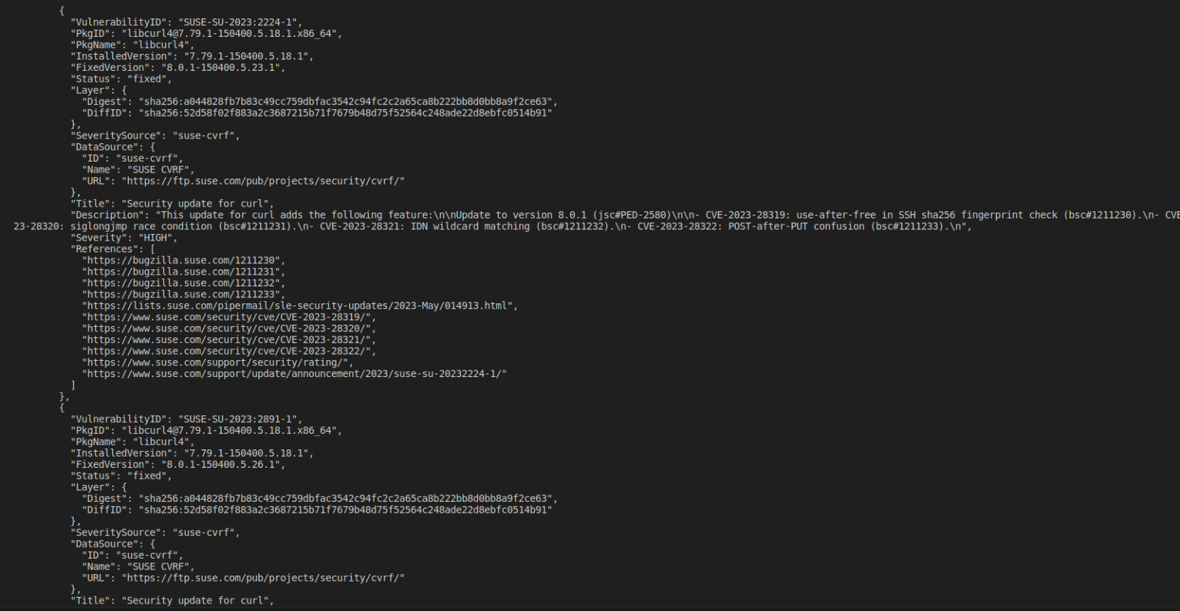
Results
Basis the prioritization of severity, we have identified a few of the most severe vulnerabilities that could potentially deal with external threats since we believe in providing foolproof security for our customers and their valuable data.

Slide 14
DEMO

Slide 15
Sprint 4

Slide 16
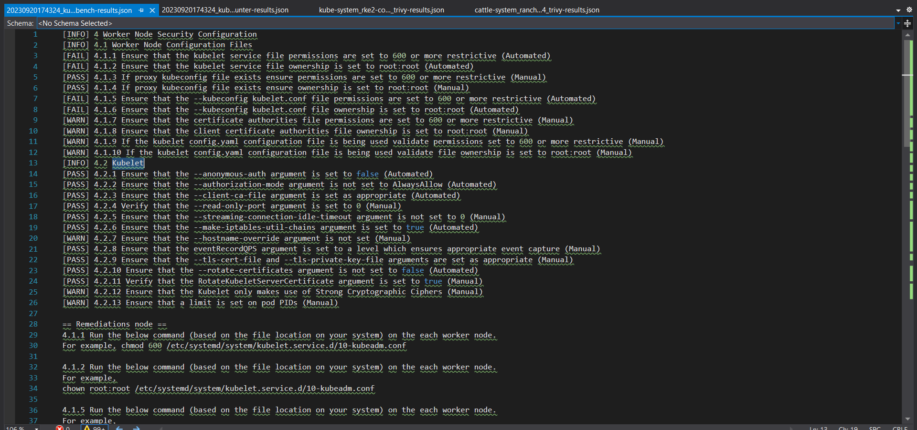
Analysing Results
Analyzed the prioritized results after running the tool on the updated cluster.

Slide 17
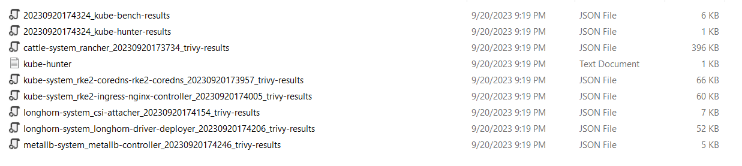
The basis of the prioritization is based on the severity and these are the most severe since they deal with the outside world

Slide 18
Analysis
Report

Slide 19
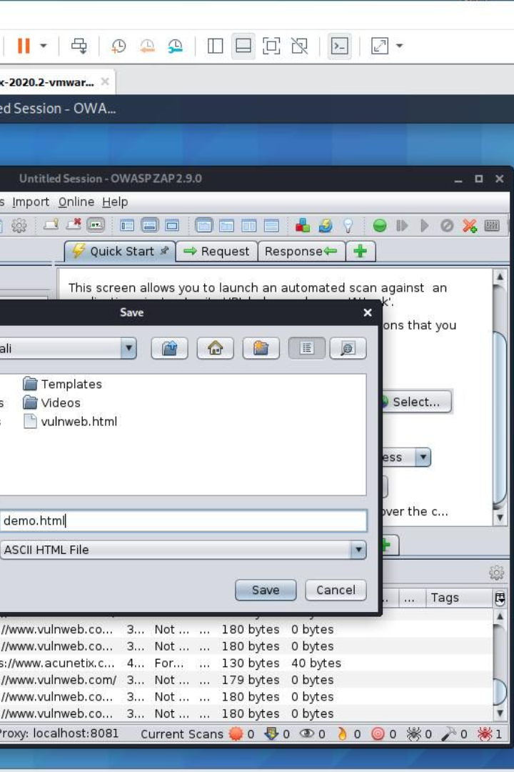
Scanning with OWASP ZAP
OWASP ZAP is one of the most widely-used open-source security testing tools designed to find vulnerabilities in web applications during development and testing. It operates as a proxy server, intercepting and inspecting the communication between the user's browser and the web application. Its primary mission is to help developers, security testers, and organizations identify and mitigate security risks early in the software development lifecycle. OWASP ZAP provides a comprehensive suite of features and customized tests, generating reports and integrating with CI/CD pipelines, ensuring the bolstering of your web application security.

Slide 20
Guide Document
Guide Presentation

Slide 21

Enhancements
Automate the analysis process
Add more tools to the vulnerability scanning tool

Slide 22
Thank You!
Thank you an I hope the presentation has been informative and helped you understand better how we can provide you with the best security measures for your business.

